Slide 1
Serverless Infrastructure With Azure Containers
Magnus Ahlkvist
He/Him
SQL Server consultant
Transmokopter SQL AB

Slide 2
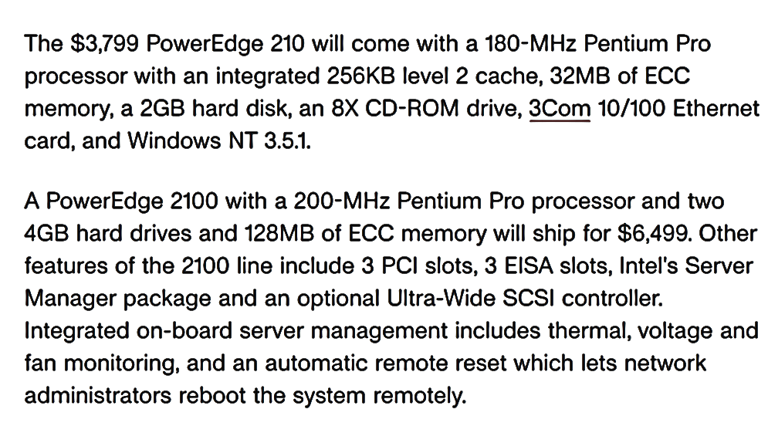

Slide 3
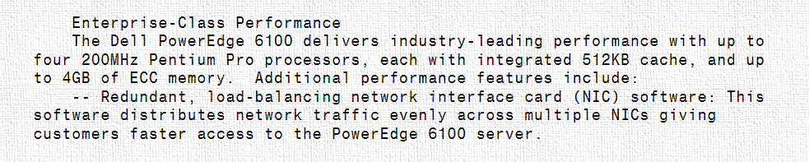

Slide 4
Deploying a new system in year 2000
Order hardware
Assemble hardware
Configure network
Configure OS
Install SQL
Deploy database

Slide 5
Some of my tasks as an accidental DBA in year 2000
Check if disks are near capacity
Order new disks and controllers and build a new RAID array in the server
Replace faulty disks
Add a new CPU to the database server
Deploy database changes with manual script execution

Slide 6
Since then, a thing or two changed

Slide 7



Magnus
Ahlkvist
SQL Server Consultant
Developer gone DBA
SQL Server 6.5 =>
Consultant
Community Organiser
Data Platform MVP
Transmokopter SQL AB
@transmokopter
github.com/transmokopter
YouTube.com/c/transmokopter

Slide 8
Revolution 1 Storage Area Network

Slide 9
Revolution 2 Virtualisation

Slide 10
Revolution 3 Containers

Slide 11
Revolution 4 Cloud containers

Slide 12
And that’s just on the hardware side of things

Slide 13
Demo
Dockerfile walkthrough
Build container images
Azure container registry
Size matters – keep your containers small
Containerize application with app and database
Deploy containerised app as container group to Azure Container Instance

Slide 15
Start playing, it really isn’t all that hard. It’s just “running your code on someone elses computer”
Magnus Ahlkvist
Twitter: @transmokopter
YouTube.com/c/transmokopter
Github: transmokopter

